Slide 1
Ambient Clinical Intelligence & Patient Experience Analytics
Figma Mockup

Slide 2
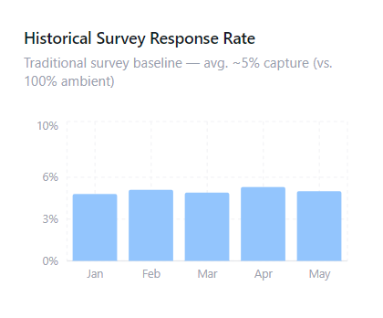
Problem Statement: The Survey Bottleneck
The Data Gap: Current post-visit surveys yield ~5% response rates, typically capturing only extreme sentiments long after the appointment.
The Operational Blindspot: Without real-time, objective data on provider interactions, leadership cannot proactively improve patient trust or treatment compliance.
The Goal: Move from delayed, anecdotal complaints to a 100% passive feedback capture system.

Slide 3
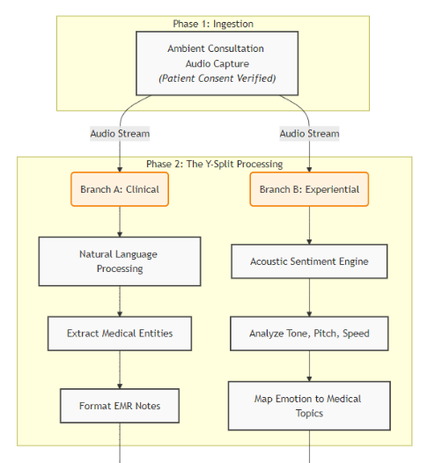
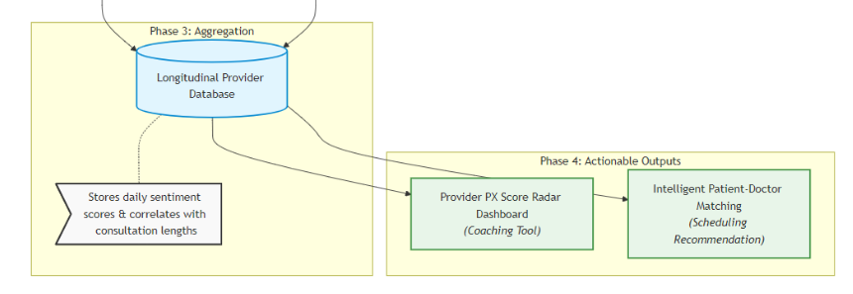
Architecture
Data Repurposing: Utilize the ambient consultation audio already being captured for automated EMR charting.
Simultaneous Processing: A "Y-Split" data flow routes audio to both Clinical (NLP for EMRs) and Experiential processing engines simultaneously.
Acoustic Sentiment: Analyzes biometric voice markers (tone, pitch, speed) to gauge patient comfort without requiring active survey participation.

Slide 4
Executive Impact
Unbiased Data: Eliminates survey fatigue by gathering passive feedback natively during every visit.
Real-Time ROI: Immediately tracks global sentiment shifts and flags critical friction alerts.
Longitudinal Tracking: Replaces static data snapshots with continuous tracking of hospital-wide patient trust and comfort trends.

Slide 5
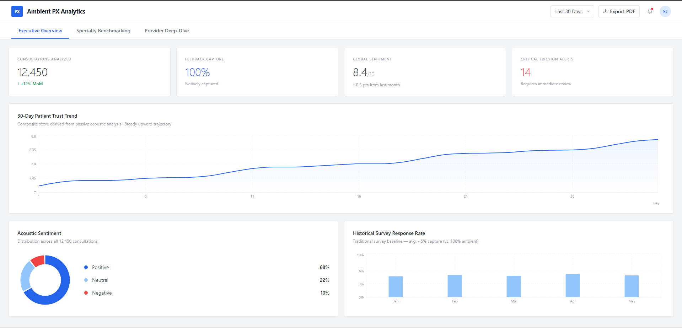
Executive Dashboard

Slide 6
Speciality Benchmarking
Departmental Comparison: Aggregates performance to compare communication efficacy across different specialties (e.g., Cardiology vs. Pediatrics).
Targeted Interventions: Maps specific friction points (e.g., "Wait Time Anxiety" or "Treatment Confusion") to the departments where they occur most frequently.
Resource Optimization: Allows leadership to allocate coaching and scheduling resources based on objective, departmental needs.

Slide 7
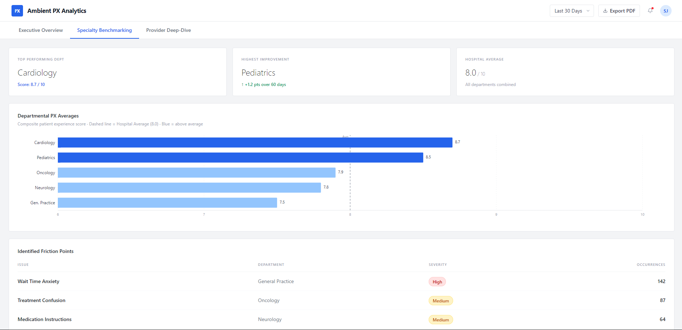
Speciality Benchmarking Dashboard

Slide 8
Provider Analytics
Contextual Scoring: The PX Score Radar visually scores providers on Empathy, Clarity, and Efficiency based on acoustic data.
Fatigue Tracking: Identifies interaction drop-offs (e.g., declining clarity during afternoon shifts) to adjust scheduling.
Deployment Risks & Mitigation:
Adoption: Must be positioned for private professional development, not punitive monitoring.
Consent: Requires seamless, non-alarming front-desk workflows.
Bias: Algorithm requires human oversight to prevent socio-economic segregation in patient-matching.

Slide 9
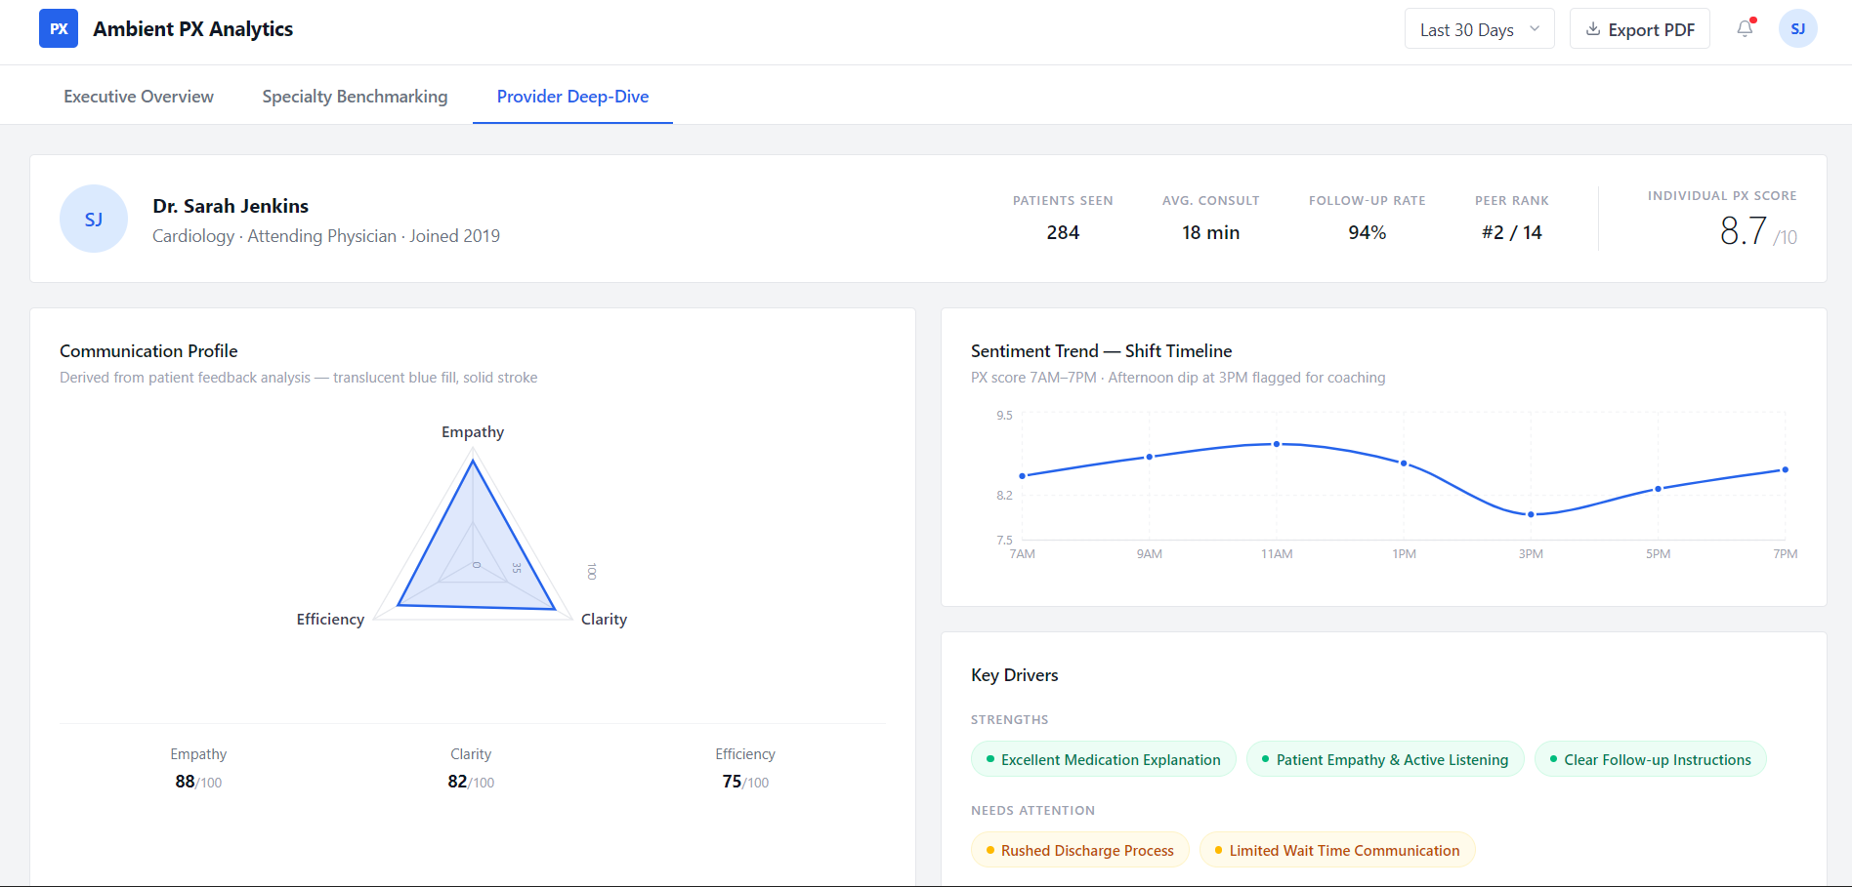
Provider Dashboard

Slide 10
Thank You

